Slide 1
Predictive Modeling of Red Tide Events Using Machine Learning
Matthew Duus, Carter Baker, Callie Unterreiner, Hayden Parks

Slide 2
Objective
Use environmental parameters from the Caloosahatchee River to develop a machine learning model to predict red tide occurrences.
Nitrogen concentration
Phosphorous concentration
Karenia brevis concentration
River discharge
Precipitation
Wind speed/direction
Sea surface temperature
Data sources: USGS, NOAA, Water Atlas, Copernicus Marine Data

Slide 3
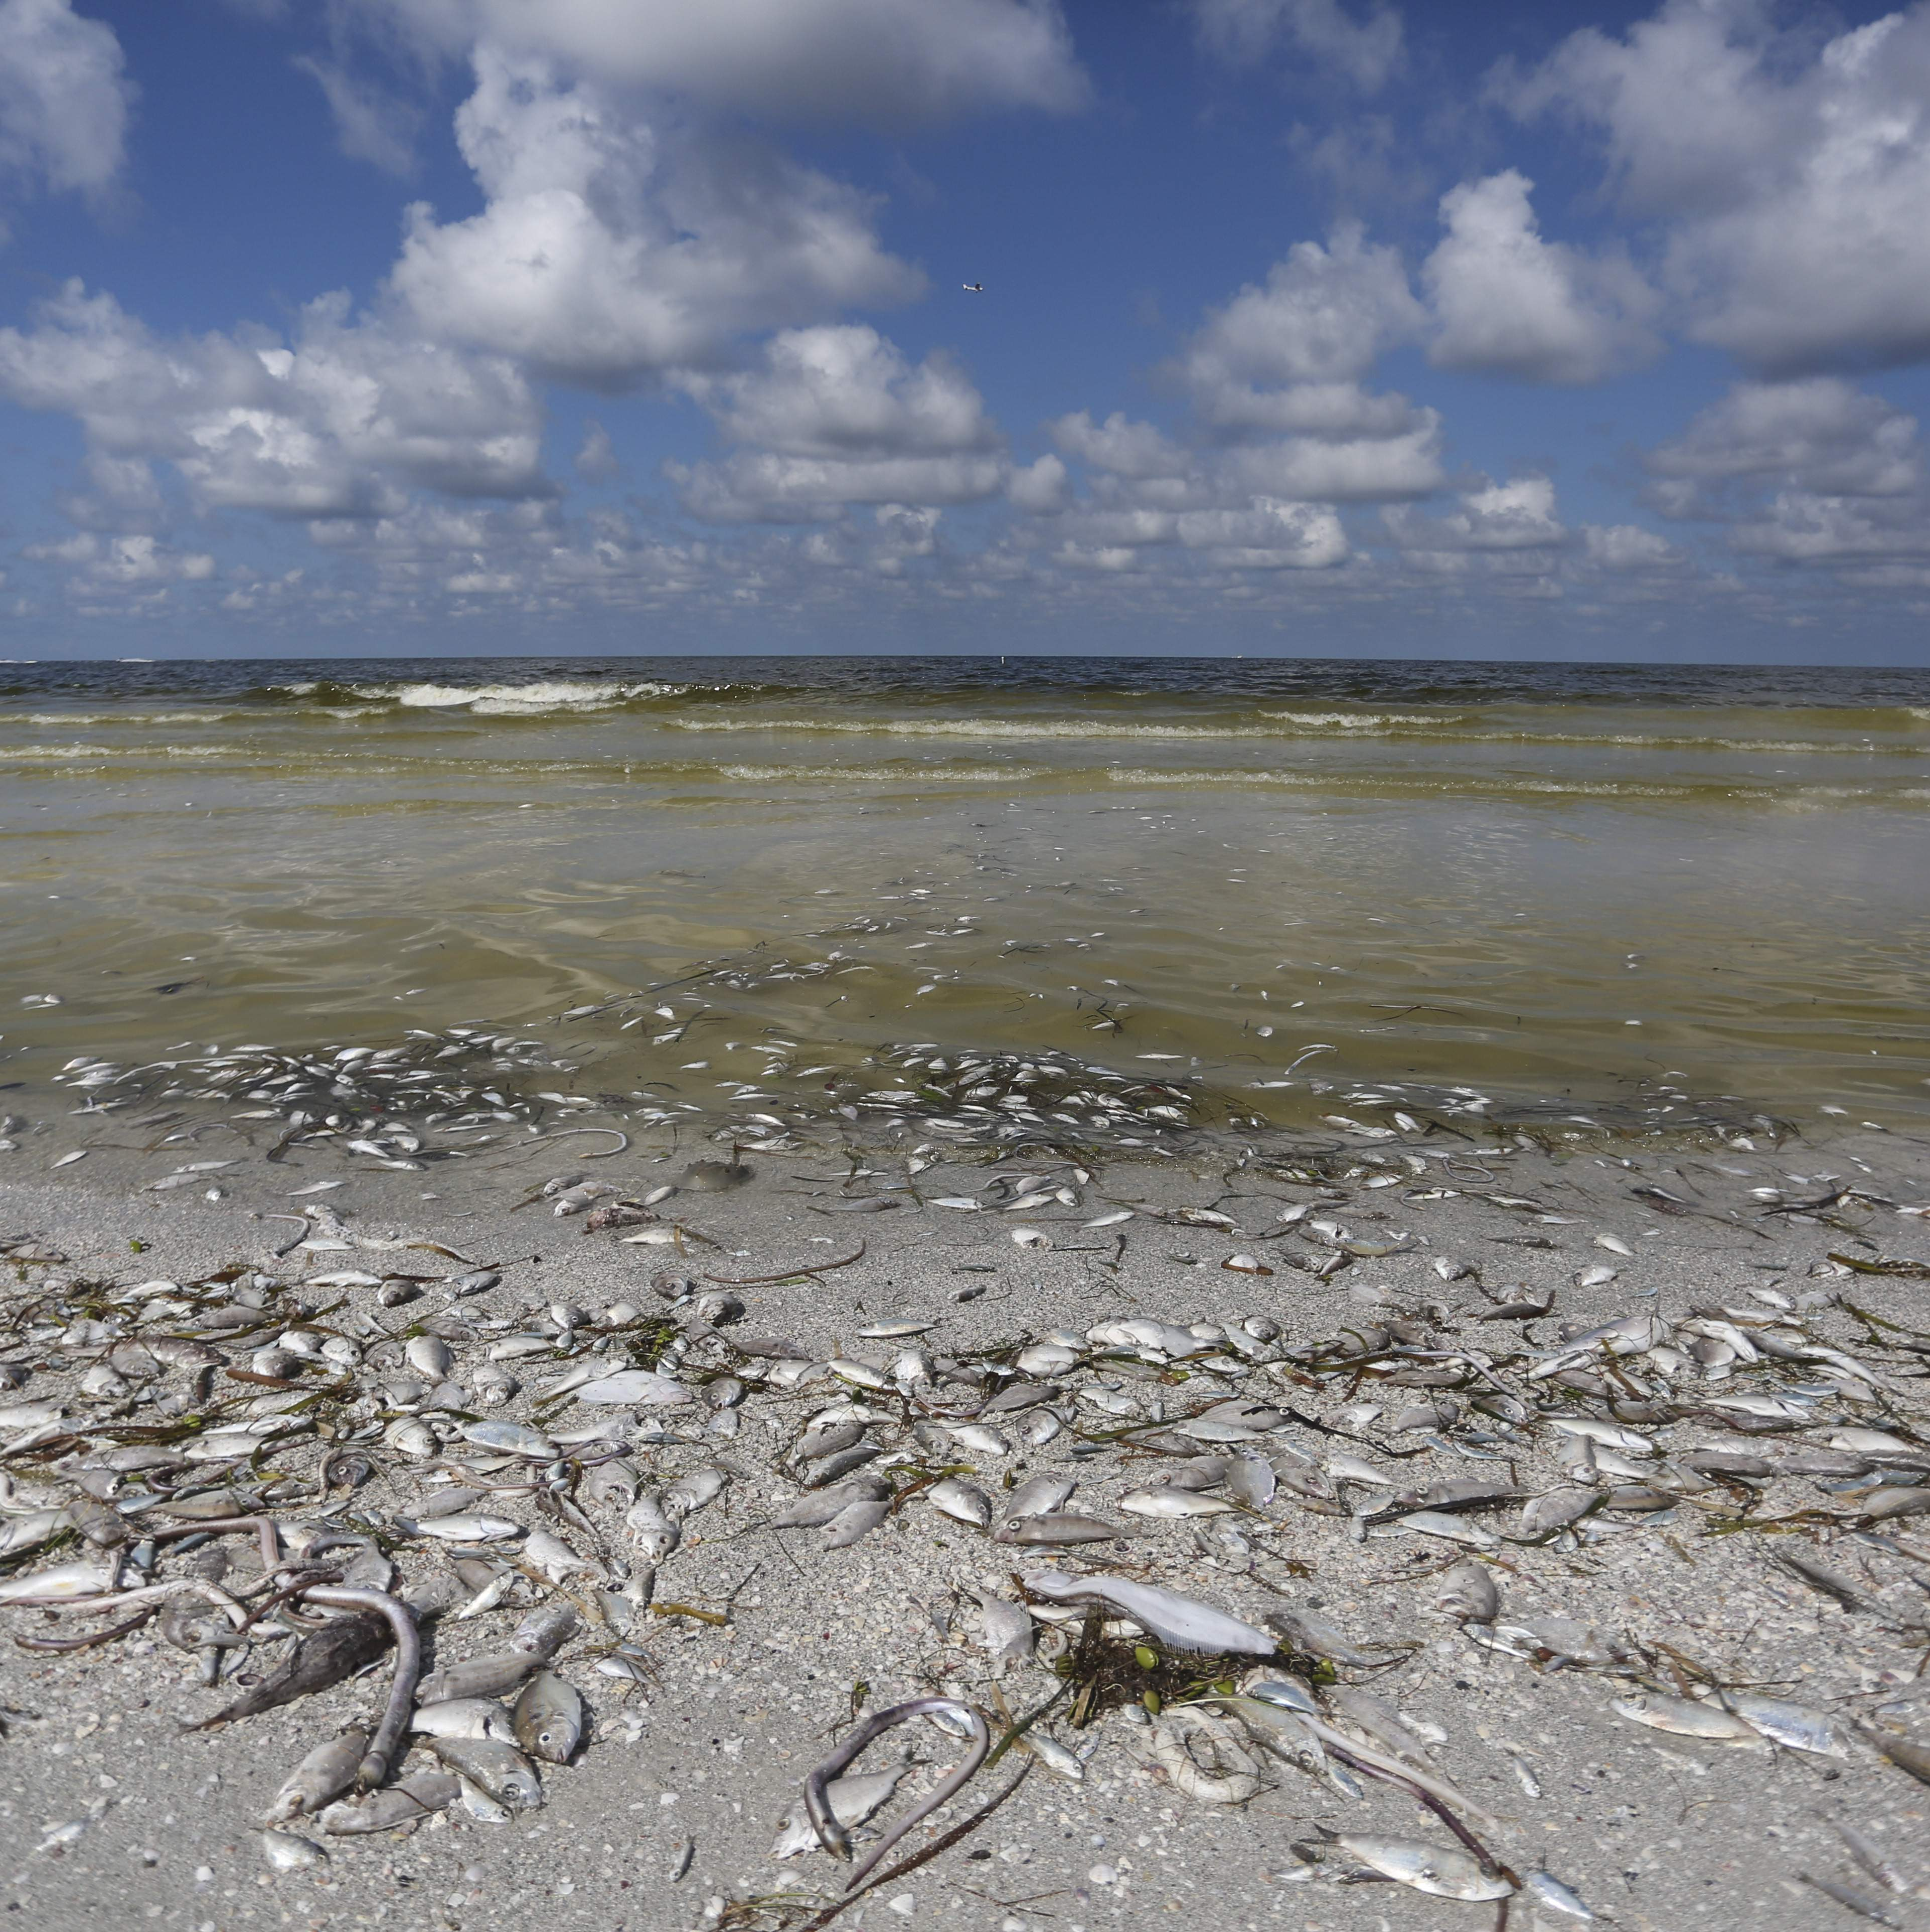
What is Red Tide?
Red Tide refers to harmful algal blooms caused primarily by Karenia brevis
Eutrophication
Nutrient loading: Nitrogen and Phosphorous
Harmful to fish, marine life, and humans
Respiratory irritation, nausea, mass fish and marine life kills, death possible
Environmental degradation and economic downturn
Credit: Tampa Bay Times, 2019

Slide 4
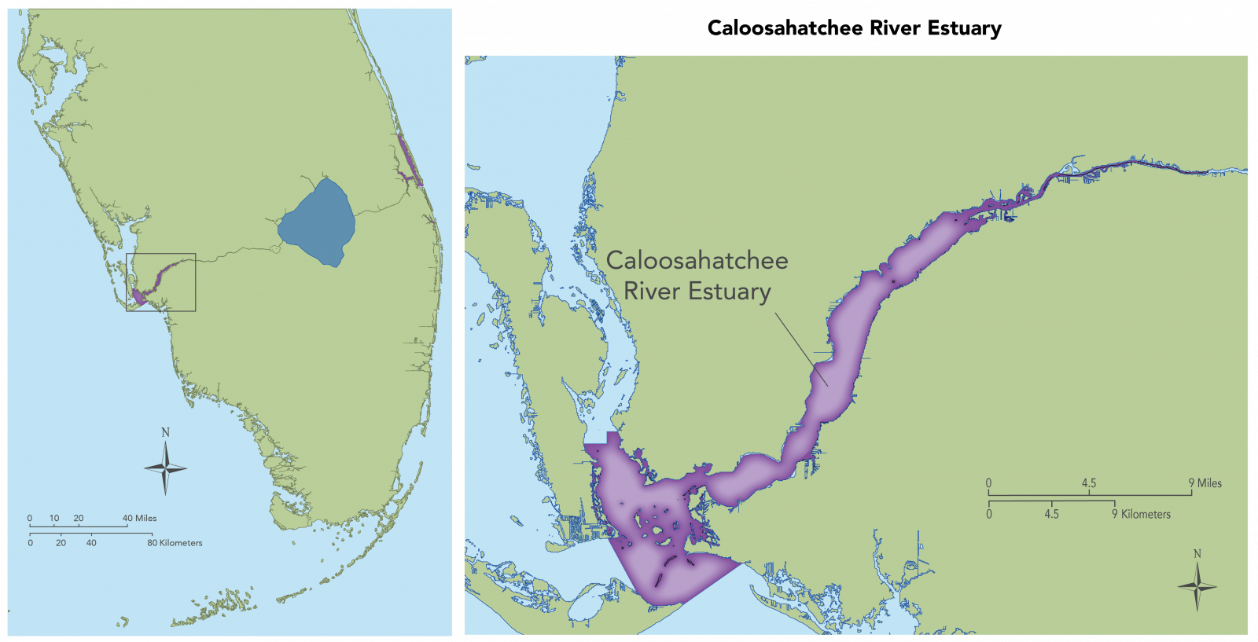
Location in Question - Caloosahatchee River

Slide 5
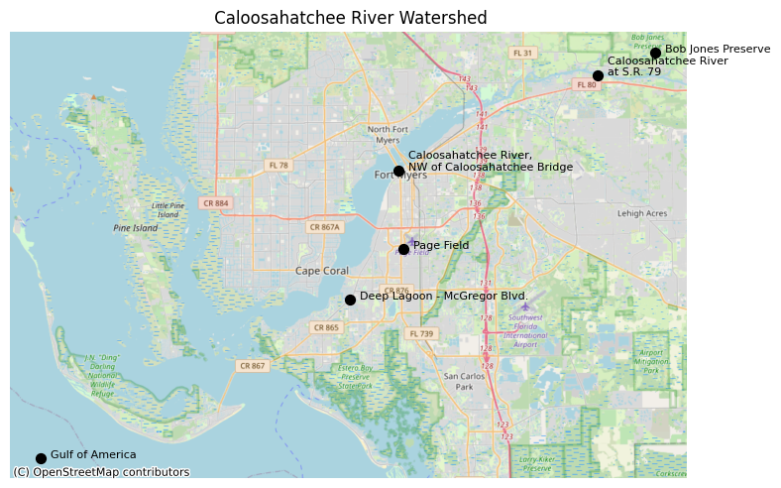
Watershed & Stations

Slide 6
Initial Data Manipulation and Environmental Condition Visualization

Slide 7
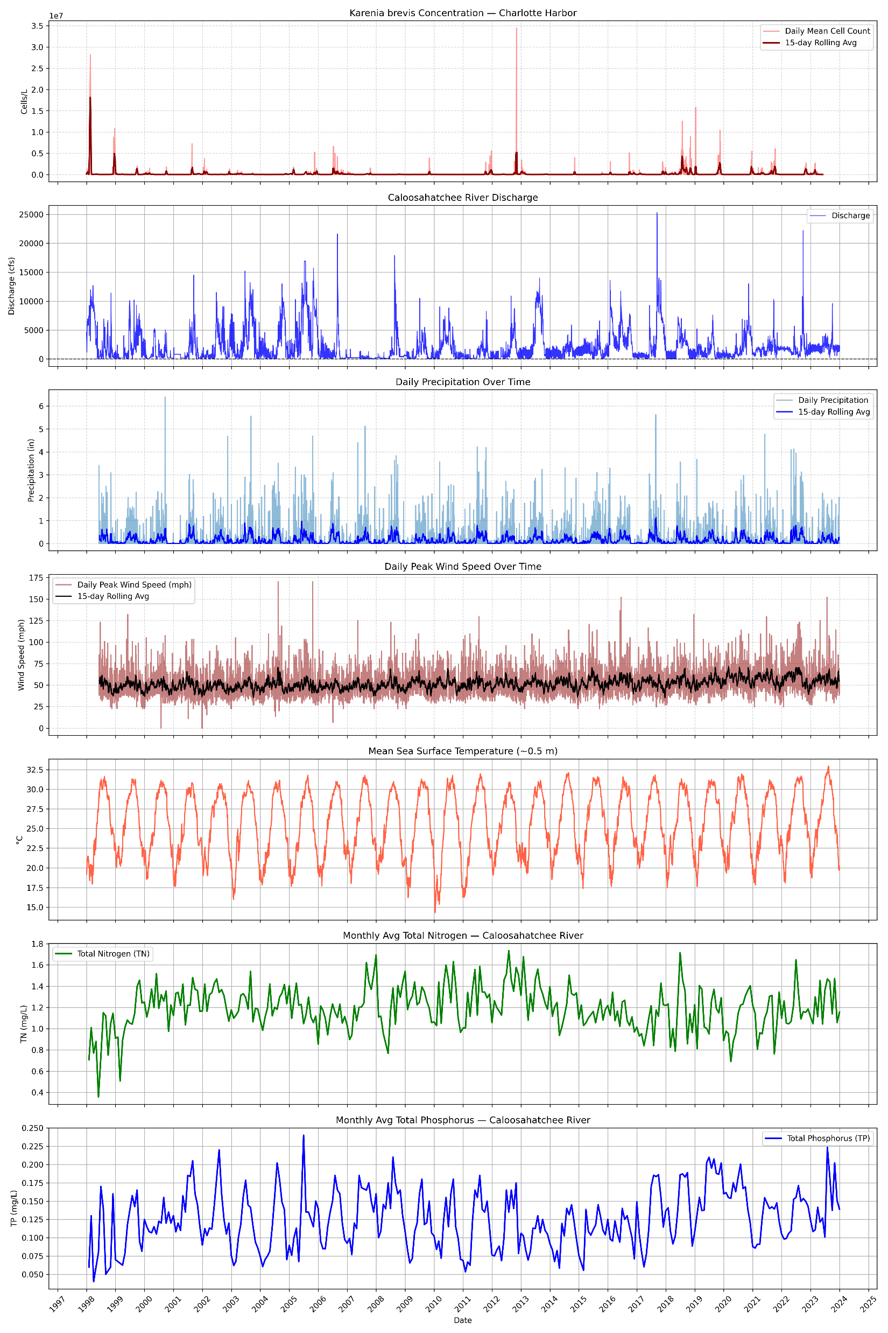

Slide 9
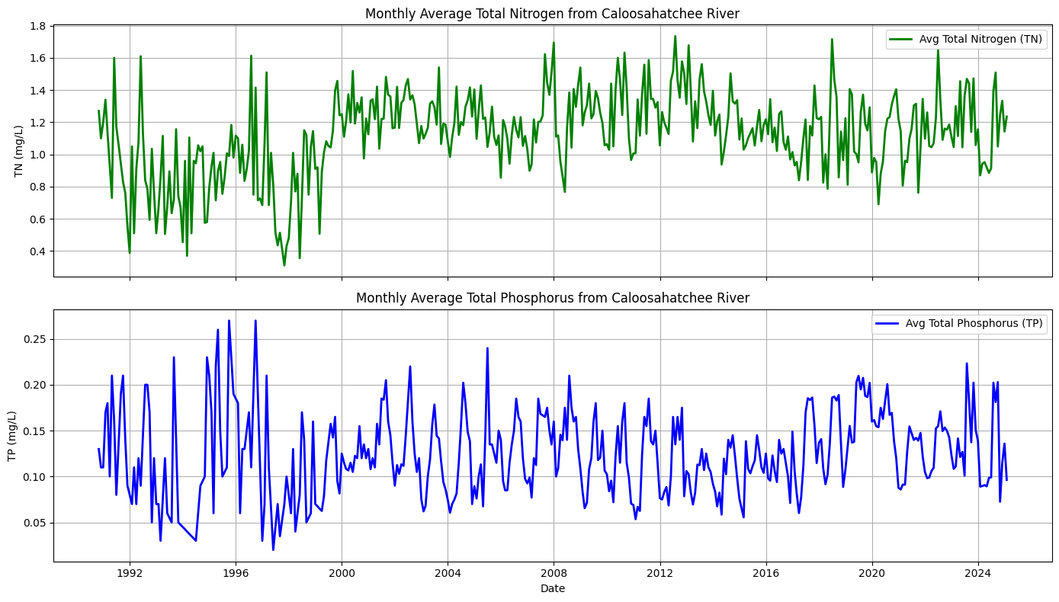

Slide 10
Seasonal Variation for Multiple Environmental Conditions

Slide 11
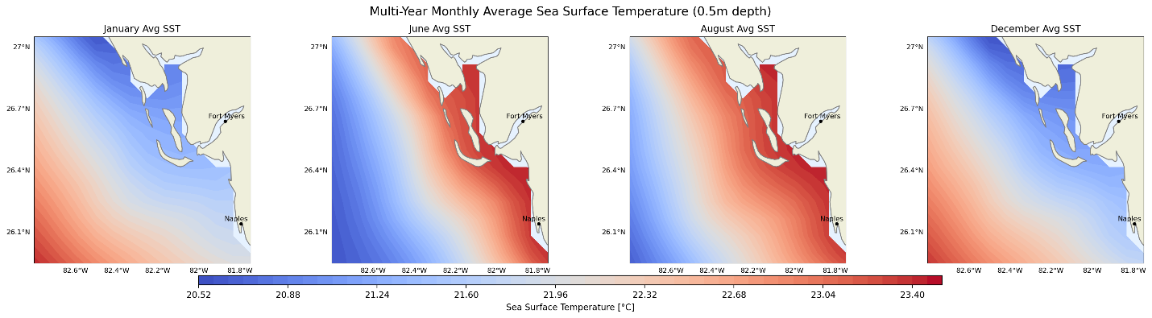
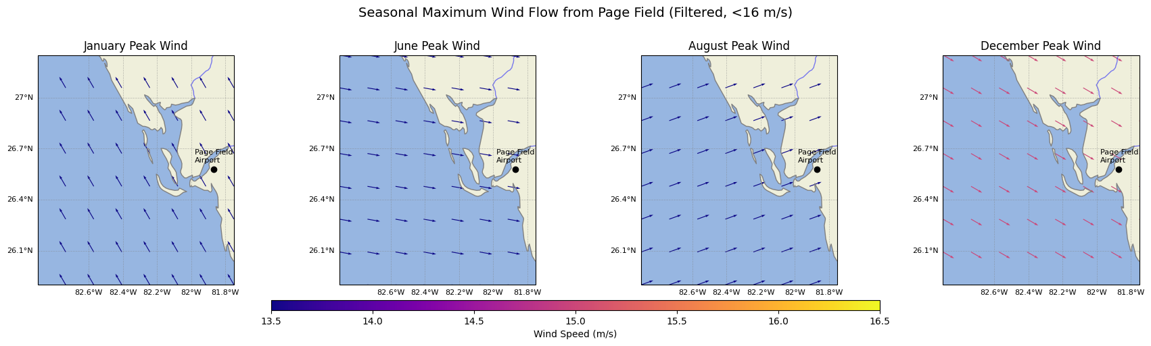

Slide 12
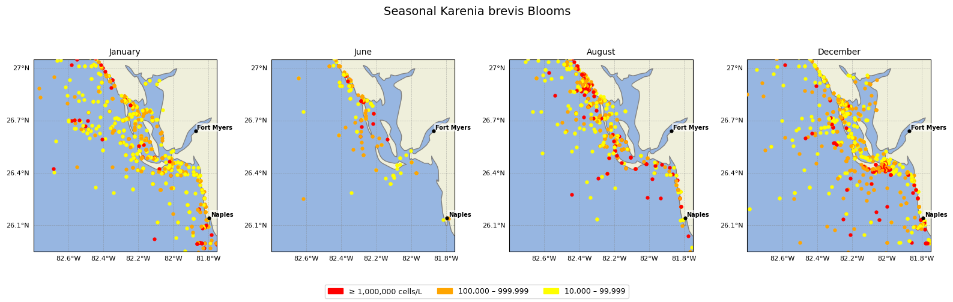

Slide 13
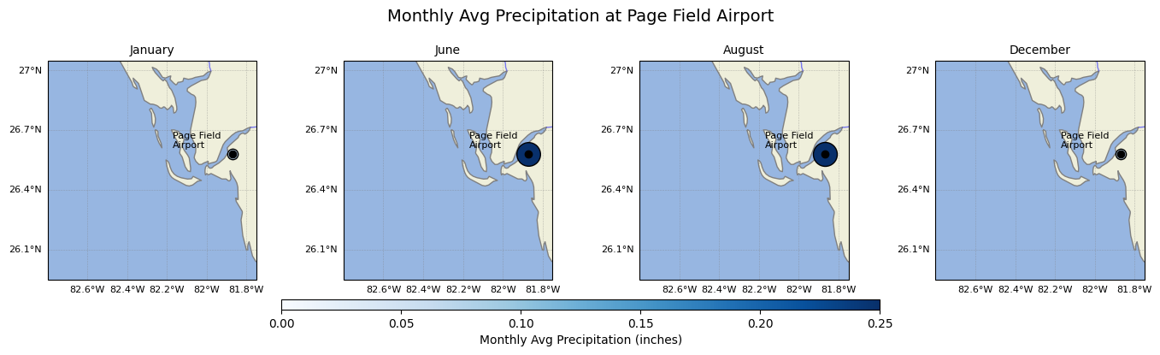
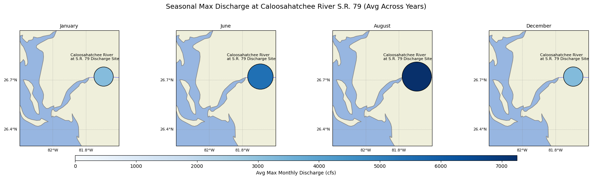

Slide 14
Nutrient Loading - Station Locations

Slide 15
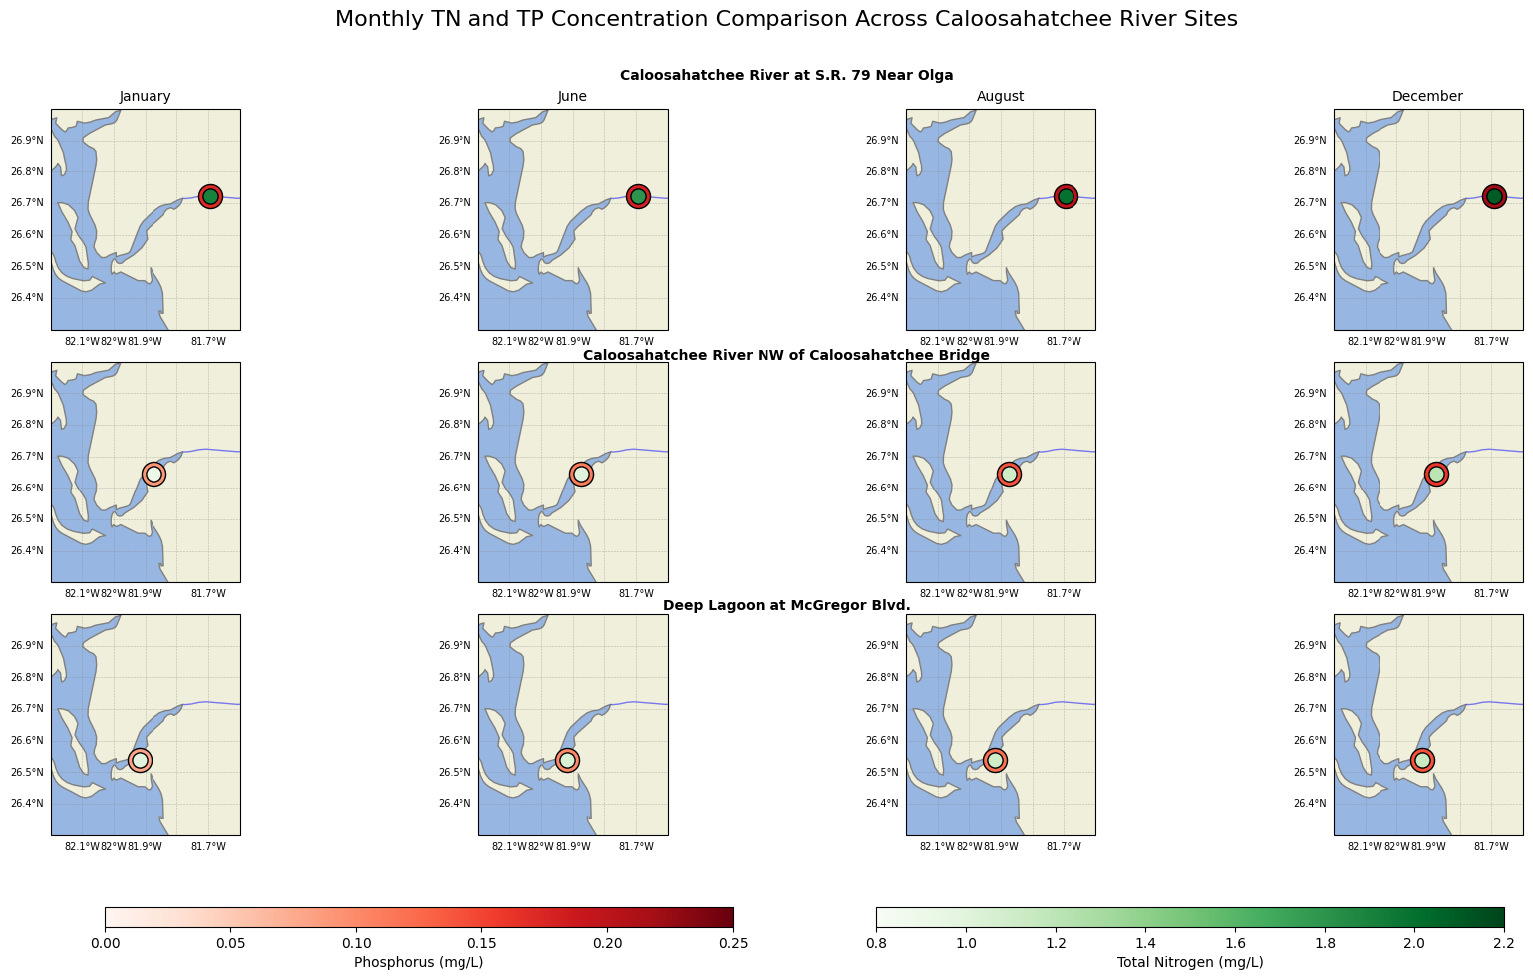

Slide 16
Machine Learning and Predictive Modeling

Slide 17
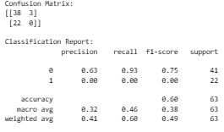
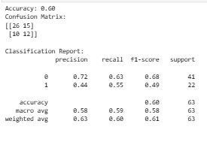
Predictive Modeling: Random Forest and Logistic Regression
Random Forest
Logistic Regression

Slide 18
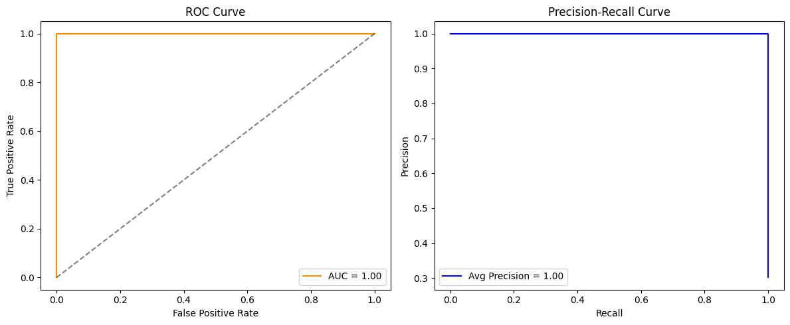
ROC-AUC and Precision Recall Curves

Slide 19
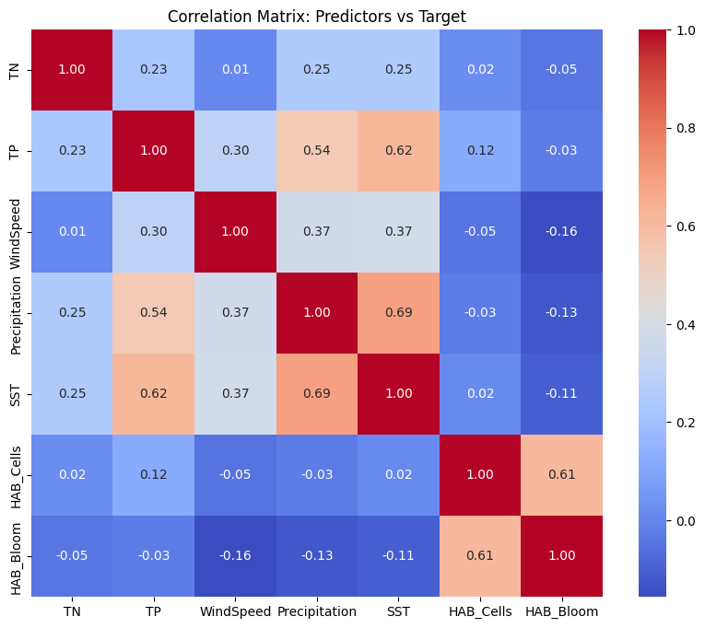
Correlation Matrix
Data leakage suspected
Model learned outcome from its definition rather than independent environmental factors

Slide 20
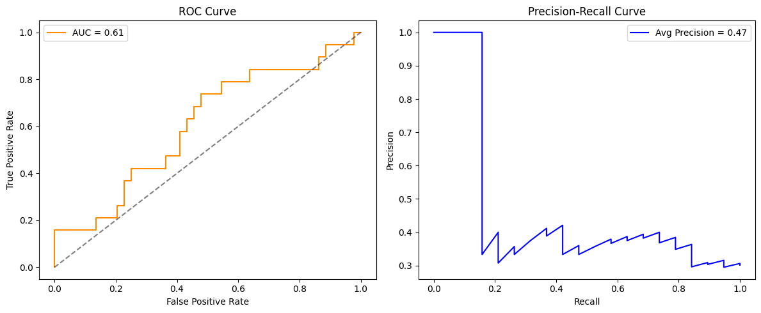
Evaluating Model Robustness [Data Leakage Solved]

Slide 21
Machine Learning Results Summary
61% true positive rate (AUC) after data leakage solution
73% accuracy – Random Forest model
- Struggles to identify bloom events effectively
59% accuracy – Logistic Regression Model
- Improved sensitivity to bloom events [identified 8/19 - recall 0.42]
Suggests limited variability in environmental factors, requiring more robust data input

Slide 22
Challenges
Overcoming data leakage
Understanding how machine learning operates
Data manipulation for multiple environmental conditions

Slide 23
Questions?

